Slide 1


MEDICAL IMAGE ANALYSIS:
TSP- AI ML Fundamentals (Capstone Project)
Presented By:
KARTHIKEYAN M – au810021114039
Guided By:
Dr.V.C.SATHISH GANDHI,M.E,MBA,PH.D.

Slide 2
OUTLINE
Problem Statement (Should not include solution)
Proposed System/Solution
Algorithm & Deployment
GitHub Link
Project Demo(photos / videos)
Conclusion
Future Scope
References

Slide 3
Problem Statement
Medical image analysis is a critical field in healthcare, where computer vision and artificial intelligence (AI) techniques are used to analyze medical images for disease detection, diagnosis, and treatment planning. This process involves the extraction of valuable insights from medical imaging modalities such as X-rays, CT scans, MRIs, and ultrasound images.

Slide 4
Proposed Solution
The proposed solution for medical image analysis involves creating an AI-powered system that automatically detects diseases like cancer or stroke from medical images (X-rays, CT scans, MRIs). It uses machine learning to identify abnormalities, segment important areas (like tumors), and provide diagnostic suggestions. The system works quickly, helping doctors spot issues faster, improve diagnostic accuracy, and save time, ultimately leading to better patient outcomes.

Slide 5
Algorithm & Deployment
Algorithms like convolutional neural networks (CNNs) are widely used for tasks such as segmentation, classification, and detection. Deployment involves integrating these trained models into clinical workflows using tools like Docker for containerization and frameworks like TensorFlow Serving for real-time inference.

Slide 6
GitHub Link
https://github.com/Karthikeyan2110/au810021114039_KARTHIKEYAN_M.git

Slide 7
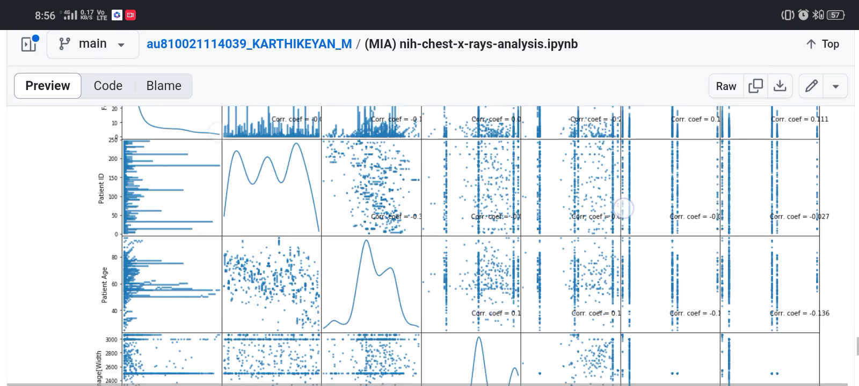
Project Demo(Recorded Video)

Slide 8
Conclusion
This Medical Image Analysis system design ensures the integration of deep learning technologies with a user-friendly interface, allowing healthcare professionals to efficiently analyze medical images and make informed decisions. By focusing on image preprocessing, accurate model predictions, result visualization, and feedback mechanisms, the system offers a comprehensive and scalable solution for improving medical diagnosis.

Slide 9
Future Scope
The future of medical image analysis is highly promising, with advancements in artificial intelligence (AI) and machine learning driving significant improvements in diagnosis and treatment planning. AI-powered tools can analyze medical images faster and more accurately, assisting radiologists in detecting abnormalities like tumors and fractures. Integration with other healthcare data sources will enable more personalized medicine.

Slide 10
References
1. Project Github link, Dr.V.C.Sathish Gandhi, 2024
2. Project video recorded link (youtube/github),Dr.V.C.Sathish Gandhi, 2024
3. Project PPT & Report github link, Dr.V.C.Sathish Gandhi , 2024

Slide 11
THANK YOU

